Slide 1
A Commodity Search System For Online Shopping
By:
M. Krishna – 150030550
MD. Sahil Afrid Farookhi – 150030590
M. Amrutha – 150030597

Slide 2
Content
Adobe Dreamweaver
Web Technologies
HTML
A Commodity Search System For Online Shopping Project

Slide 3
Adobe Dreamweaver
Adobe Dreamweaver is a proprietary web development tool developed by Adobe Systems.
Dreamweaver was created by Macromedia in 1997, and was maintained by them until Macromedia was acquired by Adobe Systems in 2005.
Adobe Dreamweaver is available for macOS and for Windows.
Present version is 18.0, CC.

Slide 4
Web Technologies
Web technology refers to the means by which computers communicate with each other using markup languages and multimedia packages.
It gives us a way to interact with hosted information, like websites.
Different Web Technologies:
HTML & CSS
HTML5
MVC Framework
jQuery
JavaScript , many more…

Slide 5
HTML
Hypertext Markup Language (HTML) is the standard markup language for creating web pages and web applications. With Cascading Style Sheets (CSS) and JavaScript it forms a triad of cornerstone technologies for the World Wide Web.
Web browsers receive HTML documents from a web server or from local storage and render them into multimedia web pages.
HTML describes the structure of a web page semantically and originally included cues for the appearance of the document.

Slide 6
A Commodity Search System For Online Shopping Project
With the popularity of Internet and e-commerce, the number of shopping websites has rapidly increased on the Internet, and this enables people to shop easily through the Internet.
Consumers spend a lot of time searching commodity, because they need to filter and compare search results data by themselves.
In recent years, there is a growing parity websites helping consumers to buy cheaper commodity.
Although these websites can help consumers get the parity price of commodities, the search results are not so ideal.

Slide 7
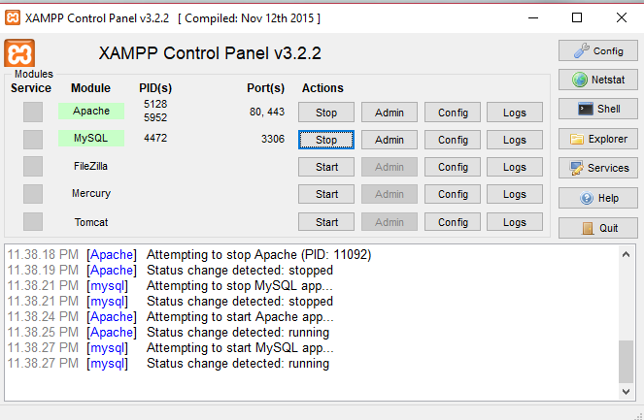
XAMPP Control Panel

Slide 8
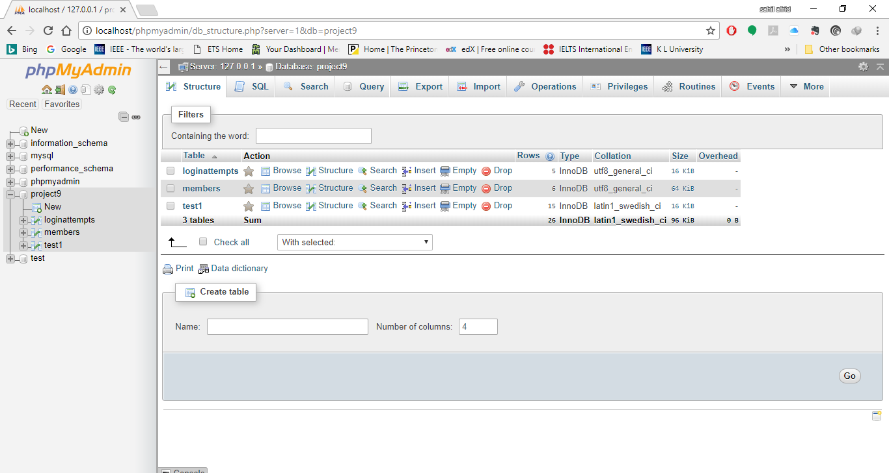
phpMyAdmin Console

Slide 9
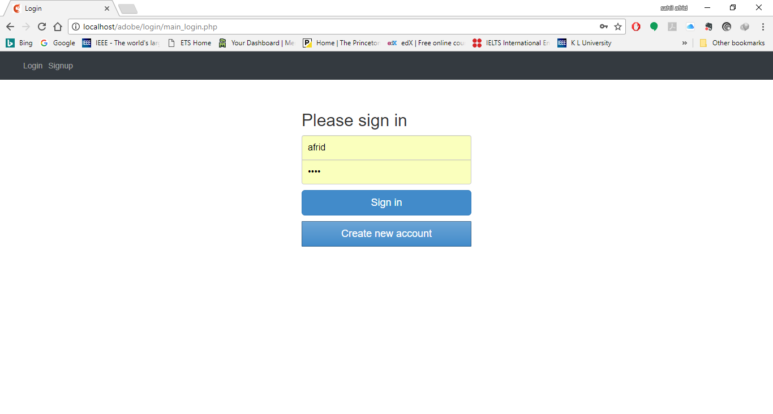
Login Page

Slide 10
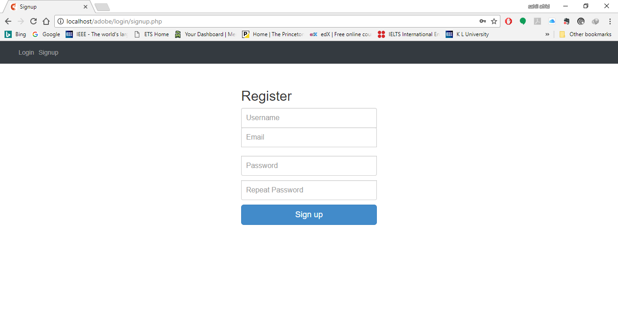
Signup Page

Slide 11
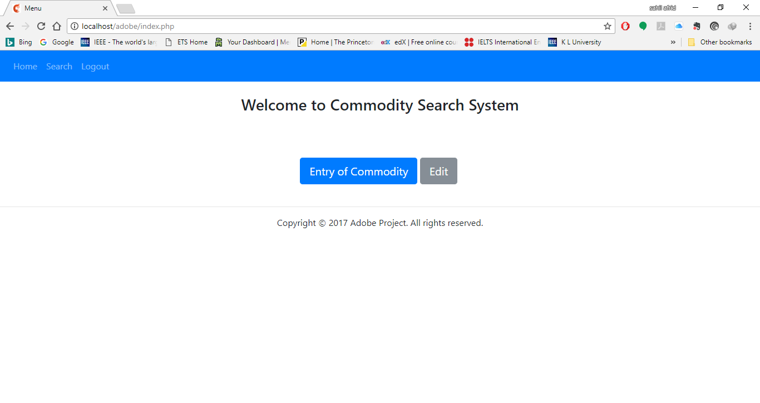
Home Page

Slide 12
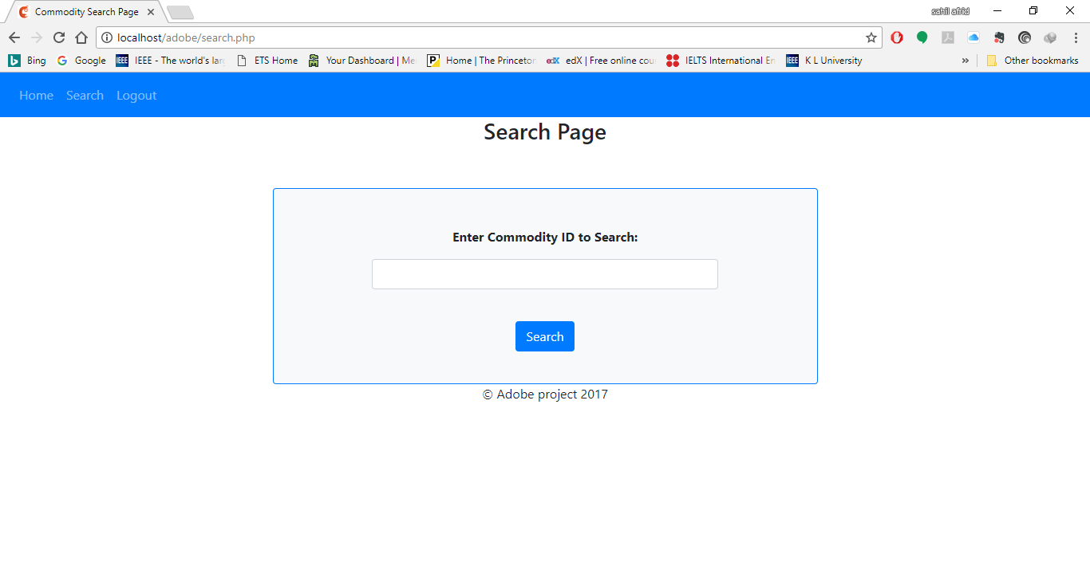
Search Page

Slide 13


